Slide 1
HTML 5 for Web Development

Slide 2
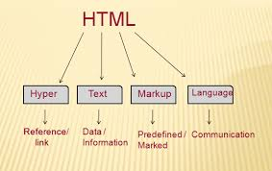
Hypertext Markup Language (HTML)
HTML
HTML stands for Hyper Text Markup Language
HTML is used to create web pages.
HTML is a format that tells a browser how to display a web page.
An HTML file is a text file containing small markup tags
HTML documents are plain text files with special "tags" or codes that a web browser uses to interpret and display information on web browser.
An HTML file must have an .html file extension.

Slide 3
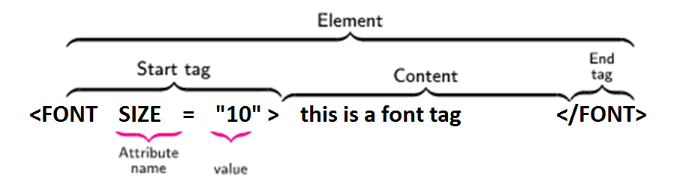
Anatomy of an HTML Element
Anatomy of an HTML element or HTML Tags/Element structure:-
  HTML tag:
    An HTML tag is surrounded by the two characters < and >.
    The surrounding characters are called angle brackets. Ex. <html>
HTML Element:
  Come in pair in which first tag is the <start tag>, the second tag is the </end tag>.
    The text between the start and end tags is the element content .
Attribute: An attribute in HTML provides extra information about the element, and it is applied within the start tag.
    An HTML attribute contains two fields: name & value.
    HTML tags are not case sensitive <B>means the same as <b>.

Slide 4
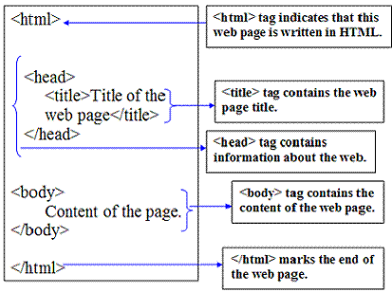
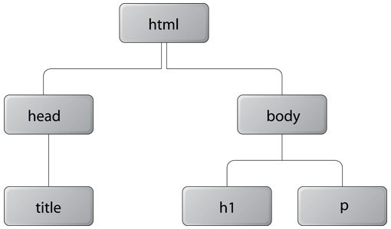
Basic Structure of an HTML document
Basic structure of an HTML document
Fig.Tree Structure of HTML Doc

Slide 5
Basic HTML5 document structure
Every HTML5 webpage begins with the following structure.
<!DOCTYPE html>
<html lang="en">
<head>
<meta charset="UTF-8">
<title>My First Webpage</title>
</head>
<body>
<h1>Welcome to HTML5</h1>
<p>This is my first webpage.</p>
</body>
</html>

Slide 6
DOCTYPE Declaration
<!DOCTYPE html>
Purpose
Declares the document as an HTML5 document.
Tells the browser which HTML version is being used.
Ensures standards mode rendering.
Prevents browsers from entering Quirks Mode.
Notes
It is not an HTML tag.
It must always be the first line of an HTML document.

Slide 7
HTML tag
HTML <html> Tag
The <html> tag represents the root of an HTML document.
The <html> tag is the container for all other HTML elements (except for the <!DOCTYPE> tag).
An HTML tag is a piece of markup language used to indicate the beginning and end of an HTML element in an HTML document.
As part of an HTML element, HTML tags help web browsers convert HTML documents into web pages.
<html lang="en">.
lang Attribute
Specifies the language of the webpage.
<html lang="fr">
French
<html lang="hi">
Hindi
<html> HTML Contents... </html>

Slide 8
Program for Displaying Welcome
<html>
<head>
</head>
<body >
welcome to web world
</body>
</html>

Slide 9
Head tag
<head> Tag
The <head> element is a container for metadata (data about data) and is placed between the <html> tag and the <body> tag.
Metadata is data about the HTML document. Metadata is not displayed.
Metadata typically define the document title, character set, styles, scripts, and other meta information.
<head>
<title>Title of the document</title>
</head>
<head>
<style>
h1 {color:red;}
p {color:blue;}
</style>
</head>

Slide 10
Body tag
HTML <body> Tag
The <body> tag defines the document's body.
Everything visible on a webpage is placed inside the body.
The <body> element contains all the contents of an HTML document, such as headings, paragraphs, images, hyperlinks, tables, lists, videos, buttons etc.
There can only be one <body> element in an HTML document.
<html>
<head>
<title>Title of the document</title>
</head>
<body>
<h1>This is a heading</h1>
<p>This is a paragraph.</p>
</body>
</html>

Slide 11
HTML Elements
HTML Elements
An HTML element consists of
Opening Tag
↓
Content
↓
Closing Tag
<p>Hello Students</p>
EMPTY ELEMENTS
Some HTML elements do not have closing tags.
Example:
<br>
<hr>
<img>
<input>

Slide 12
HTML Comments
Comments are ignored by browsers.
Used for documentation.
Syntax
<!-- This is a comment -->
Example
<!-- Header Section -->
<h1>College Website</h1>
<!-- Footer Starts -->
Shortcut in VS Code
Ctrl + /

Slide 13
HTML Semantic Elements/Tags
What are Semantic Elements?
Semantic HTML refers to using HTML elements that clearly describe the meaning and purpose of the content they contain.
A semantic element tells both the browser and the developer what kind of content it represents.
Instead of only defining how content looks, semantic elements define what the content actually is.
For example:
<header> represents the header section.
<nav> represents navigation links.
<article> represents an independent article.
<footer> represents the footer.
Examples of non-semantic elements: <div> and <span> - Tells nothing about its content.
Examples of semantic elements: <form>, <table>, and <article> - Clearly defines its content.

Slide 14
DIV tag
<div> Tag:
Block-level element:
By default, a <div> element starts on a new line and takes up the full available width of its parent container. It creates a "block" of content.
Purpose:
Primarily used for grouping larger sections of content, creating logical divisions within a webpage, and structuring the overall layout. It's common to use <div> elements for sections like headers, footers, sidebars, or main content areas.
Layout Impact:
Because it's a block-level element, a <div> significantly impacts the page layout by forcing line breaks before and after its content.
Two commonly used block elements are: <p> and <div>.
The <p> element defines a paragraph in an HTML document.
The <div> element defines a division or a section in an HTML document.

Slide 15
SPAN tag
<span> Tag:
Inline element:
By default, a <span> element does not start on a new line and only occupies as much width as its content requires. It flows within the existing line of text.
Purpose:
Primarily used for applying styles or targeting specific, smaller portions of text or inline elements within a larger block of content. This could be to change the color of a word, apply a different font style to a phrase, or add a specific class for JavaScript manipulation.
Layout Impact:
Being an inline element, a <span> does not inherently affect the page's layout in terms of line breaks or block-level spacing.

Slide 16
The <div> tag
The <div> tag defines a division or a section in an HTML document.
The <div> tag is used as a container for HTML elements - which is then styled with CSS or manipulated with JavaScript.
The <div> tag is easily styled by using the class or id attribute.

Slide 17
<!DOCTYPE html>
<html>
<head>
<style>
.myDiv {
border: 5px outset black;
background-color: lightgreen;
text-align: center;
}
</style>
</head>
<body>
<h1>The div element</h1>
<div class="myDiv">
<h2>This is a heading in a div element</h2>
<p>This is some text present in a div element.</p>
</div>
<p>This is text outside the div element.</p>
</body>
</html>
A <div> section in a document that is styled with CSS:

Slide 18
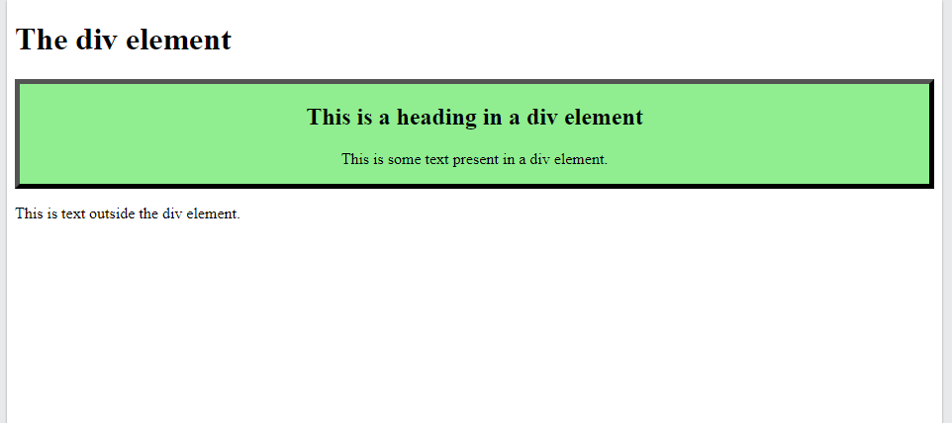

Slide 19
Block-level Elements
A block-level element always starts on a new line, and the browsers automatically add some space (a margin) before and after the element.
A block-level element always takes up the full width available (stretches out to the left and right as far as it can).
Two commonly used block elements are: <p> and <div>.
The <p> element defines a paragraph in an HTML document.
The <div> element defines a division or a section in an HTML document.

Slide 20
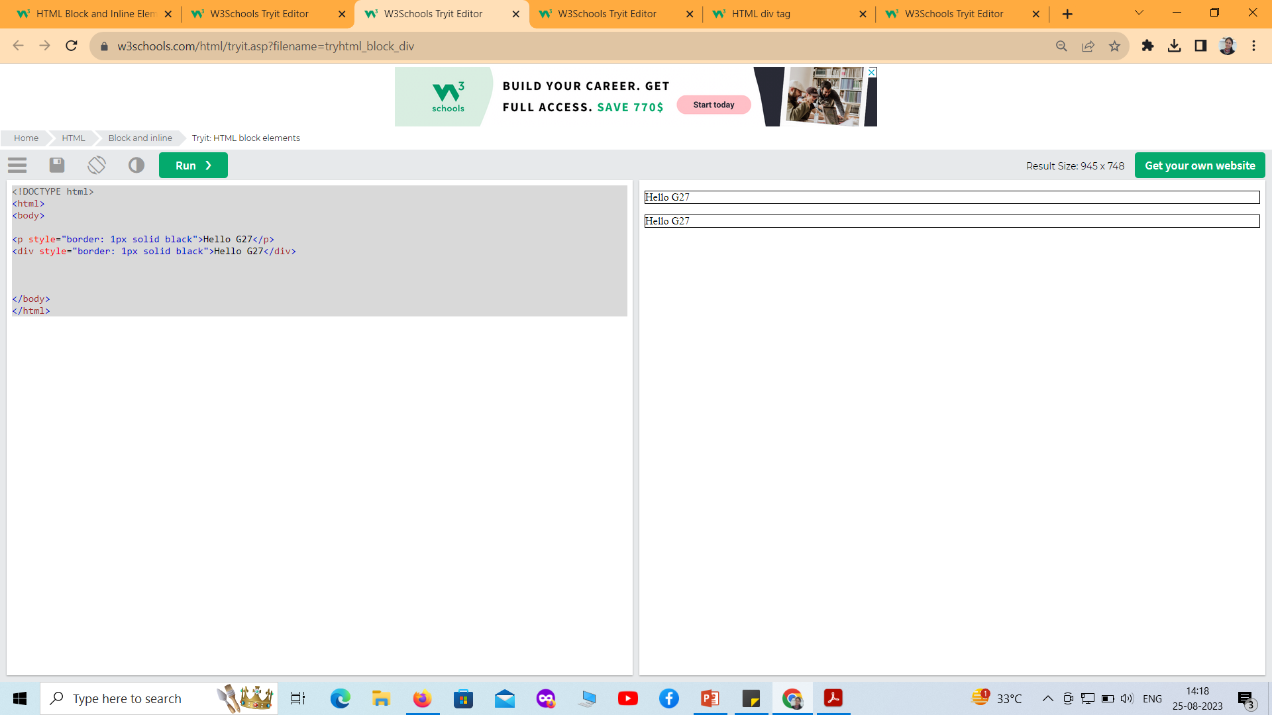
<!DOCTYPE html>
<html>
<body>
<p style="border: 1px solid black">Hello G27</p>
<div style="border: 1px solid black">Hello G27</div>
</body>
</html>

Slide 21
Inline Elements
An inline element does not start on a new line.
An inline element only takes up as much width as necessary
<!DOCTYPE html>
<html>
<body>
<p>This is an inline span <span style="border: 1px solid black">Hello World</span> element inside a paragraph.</p>
</body>
</html>
Output
This is an inline span Hello World element inside a paragraph.

Slide 22
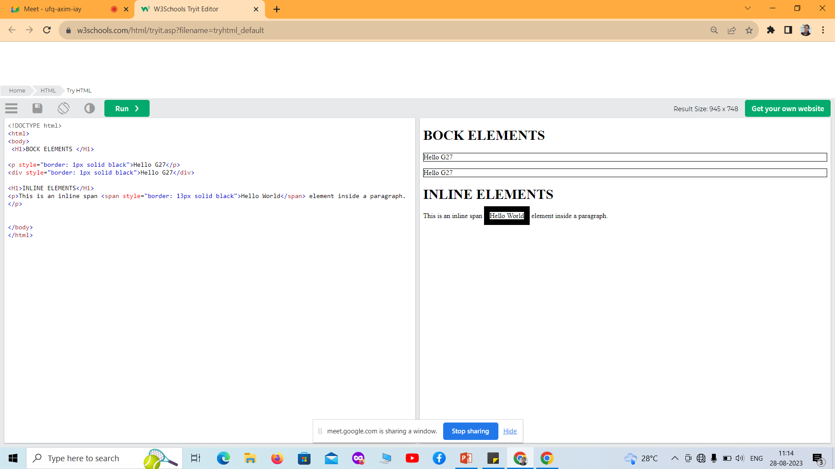

Slide 23
HTML Quotation and Citation Elements
Tag | Description
<abbr> | Defines an abbreviation or acronym
<address> | Defines contact information for the author/owner of a document
<bdo> | Defines the text direction
<blockquote> | Defines a section that is quoted from another source
<cite> | Defines the title of a work
<q> | Defines a short inline quotation
<p>The <abbr title="World Health Organization">WHO</abbr> was founded in 1948.</p>
<address>Example.com<br> Box 564, Disneyland<br> USA </address>
<bdo dir="rtl"> This text will go right-to-left. </bdo>
<blockquote cite="http://www.worldwildlife.org/who/index.html">
For 50 years, WWF has been protecting the future of nature.
</blockquote>
<p><cite>The Scream</cite> by Edward Munch. Painted in 1893.</p>
<q>Build a future where people live in harmony with nature.</q>

Slide 24
New Added Elements in HTML 5
<article>: The <article> tag represents independent, self-contained content like articles or posts.
<aside>: The <aside> tag holds secondary or related information supporting the main content.
<figcaption>: The <figcaption> tag provides a caption or description for a <figure> element.
<figure>: The <figure> tag groups self-contained media such as images, diagrams, or code.
<header>: The <header> tag contains introductory content like headings or navigation links.
<footer>: The <footer> tag includes closing content such as author info or copyright notes.
<main>: The <main> tag defines the central, most important content of the webpage.
<mark>: The <mark> tag highlights or emphasizes specific text.
<nav>: The <nav> tag groups navigation links for moving around the site.
<section>: The <section> tag organizes related content into thematic blocks.

Slide 25
New Added Elements in HTML 5
<details>: The <details> tag creates expandable or collapsible content sections.
<summary>: The <summary> tag provides the clickable heading for a <details> element.
<time>: The <time> tag represents dates or times in a readable and machine-usable format.
<bdi>: The <bdi> tag isolates text with unknown or mixed text direction.
<wbr>: The <wbr> tag adds an optional line-break position in long words.
<datalist>: The <datalist> tag provides autocomplete suggestions for an <input> element.
<keygen>: The <keygen> tag generates key pairs for secure authentication (deprecated).
<output>: The <output> tag displays results of calculations or script actions.
<progress>: The <progress> tag visually represents the progress of a task.
<svg>: The <svg> tag embeds scalable vector graphics into a webpage.
<canvas>: The <canvas> tag draws dynamic graphics using JavaScript.

Slide 26
New Added Elements in HTML 5
<audio>: The <audio> tag embeds audio content like music or sound effects.
<embed>: The <embed> tag inserts external resources such as media players or apps.
<source>: The <source> tag defines media sources for <audio> and <video> elements.
<track>:The <track> tag provides captions or subtitles for videos.
<video>: The <video> tag embeds video content directly into a webpage.

Slide 27
HTML5 Advantages
HTML5 offers several benefits that enhance modern web development like:
Works on all major browsers and devices (cross-platform).
Lets websites access user location (geolocation).
Supports offline use through Web Storage or AppCache.
Uses semantic tags for cleaner, simpler code.
Optimized for smooth performance on mobile devices.

Slide 28
HTML5 Disadvantages
Despite its strengths, HTML5 comes with some drawbacks:
Older browsers may not support all HTML5 features (browser inconsistencies).
Some older mobile devices struggle with HTML5 (mobile compatibility issues).
Web Storage and similar features can pose security risks if misused.
Advanced APIs introduce complexity for beginners.
IE 8 and below show poor support for HTML5.

Slide 29
What are Semantic Elements?
A semantic element clearly describes its meaning to both the browser and the developer.
Examples of non-semantic elements: <div> and <span> - Tells nothing about its content.
Examples of semantic elements: <img>, <table>, and <article> - Clearly defines its content.

Slide 30
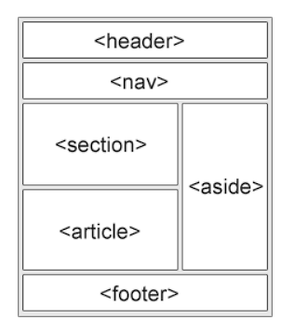
Semantic Elements in HTML
<article>
<aside>
<details>
<figcaption>
<figure>
<footer>
<header>
<main>
<mark>
<nav>
<section>
<summary>
<time>

Slide 31
HTML <section> Element
The <section> element defines a section in a document.
Examples of where a <section> element can be used:
Chapters
Introduction
News items
Contact information

Slide 32
Example
Two sections in a document:
CODE:
<section>
<h1>WWF</h1>
<p>The World Wide Fund for Nature (WWF) is an international organization working on issues regarding the conservation, research and restoration of the environment, formerly named the World Wildlife Fund. WWF was founded in 1961.</p>
</section>
<section>
<h1>WWF's Panda symbol</h1>
<p>The Panda has become the symbol of WWF. The well-known panda logo of WWF originated from a panda named Chi Chi that was transferred from the Beijing Zoo to the London Zoo in the same year of the establishment of WWF.</p>
</section>

Slide 33
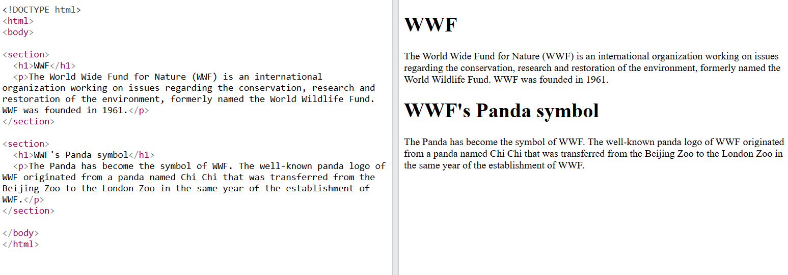
Output
Code:
<!DOCTYPE html>
<html>
<head>
<title>Section Example</title>
</head>
<body>
<section>
<h1>WWF</h1>
<p>
The World Wide Fund for Nature (WWF) is an international
organization working on issues regarding the conservation,
research and restoration of the environment, formerly named
the World Wildlife Fund. WWF was founded in 1961.
</p>
</section>
<section>
<h1>WWF's Panda symbol</h1>
<p>
The Panda has become the symbol of WWF. The well-known panda
logo of WWF originated from a panda named Chi Chi that was
transferred from the Beijing Zoo to the London Zoo in the same
year of the establishment of WWF.
</p>
</section>
</body>
</html>
Output:

Slide 34
HTML <article> Element
The <article> element defines independent, self-contained content.
The content inside an <article> should make sense on its own.
An <article> can be shared or distributed independently from the rest of the webpage.
It is commonly used for content that can stand alone.
Examples of <article> content:
Forum posts
Blog posts
User comments
Product cards
Newspaper or magazine articles
News stories

Slide 35
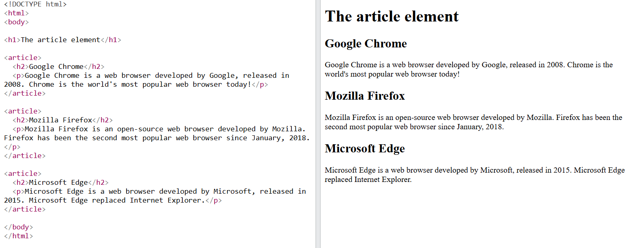
Code
<!DOCTYPE html>
<html>
<head>
<title>Article Example</title>
</head>
<body>
<h1>The article element</h1>
<article>
<h2>Google Chrome</h2>
<p>
Google Chrome is a web browser developed by Google, released in
2008. Chrome is the world's most popular web browser today!
</p>
</article>
<article>
<h2>Mozilla Firefox</h2>
<p>
Mozilla Firefox is an open-source web browser developed by Mozilla.
Firefox has been the second most popular web browser since January, 2018.
</p>
</article>
<article>
<h2>Microsoft Edge</h2>
<p>
Microsoft Edge is a web browser developed by Microsoft, released in
2015. Microsoft Edge replaced Internet Explorer.
</p>
</article>
</body>
</html>
Output:

Slide 36
Nesting <article> in <section>
The <article> element specifies independent, self-contained content.
The <section> element defines a section in a document.

Slide 37
HTML <header> Element
The <header> element represents a container for introductory content or a set of navigational links.
A <header> element typically contains:
one or more heading elements (<h1> - <h6>)
logo or icon
authorship information
Note: You can have several <header> elements in one HTML document. However, <header> cannot be placed within a <footer>, <address> or another <header> element.

Slide 38
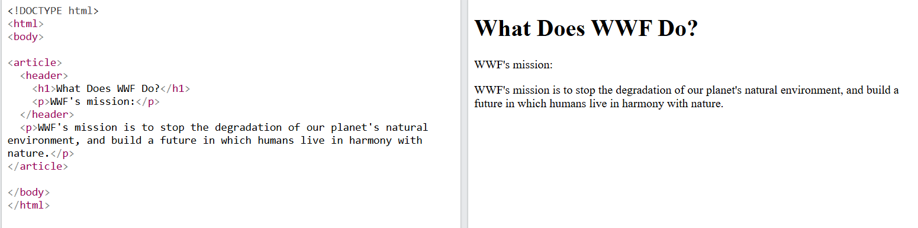
Example
Code:
<!DOCTYPE html>
<html>
<head>
<title>Header Example</title>
</head>
<body>
<article>
<header>
<h1>What Does WWF Do?</h1>
<p>WWF's mission:</p>
</header>
<p>
WWF's mission is to stop the degradation of our planet's natural
environment, and build a future in which humans live in harmony
with nature.
</p>
</article>
</body>
</html>
Output:

Slide 39
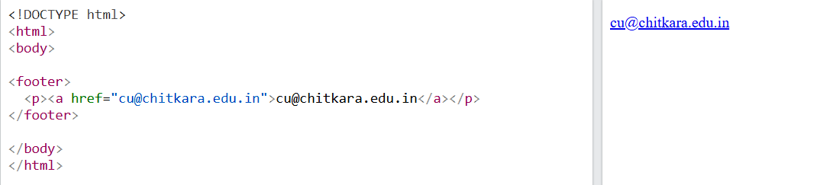
Example
Code
<!DOCTYPE html>
<html>
<body>
<footer>
<p>
<a href="mailto:cu@chitkara.edu.in">
cu@chitkara.edu.in
</a>
</p>
</footer>
</body>
</html>
Output

Slide 40
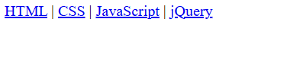
HTML <nav> Element
The <nav> element defines a set of navigation links.
Code
<!DOCTYPE html> Output:
<html>
<body>
<nav>
<a href="/html/">HTML</a> |
<a href="/css/">CSS</a> |
<a href="/js/">JavaScript</a> |
<a href="/jquery/">jQuery</a>
</nav>
</body>
</html>

Slide 41
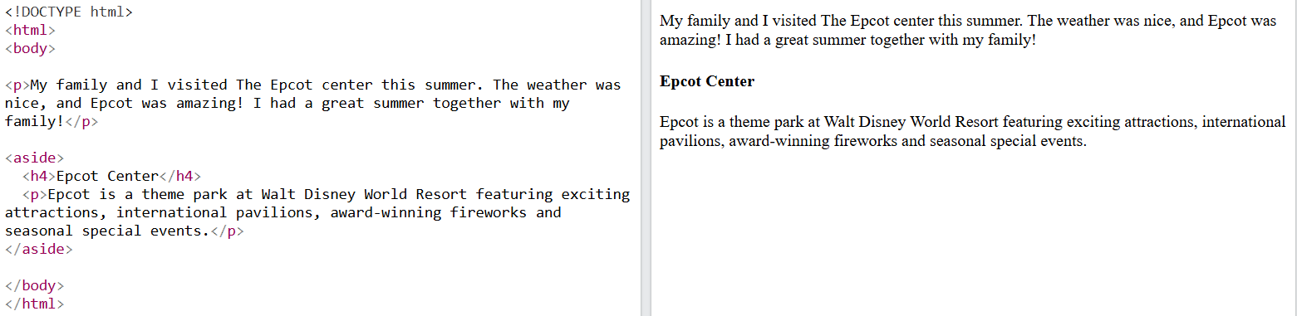
HTML <aside> Element
The <aside> element defines some content aside from the content it is placed in (like a sidebar).
The <aside> content should be indirectly related to the surrounding content.
Example
<!DOCTYPE html><html> Output:
<body>
<p>
My family and I visited The Epcot center this summer.
The weather was nice, and Epcot was amazing!
I had a great summer together with my family!
</p>
<aside>
<h4>Epcot Center</h4>
<p>
Epcot is a theme park at Walt Disney World Resort
featuring exciting attractions, international
pavilions, award-winning fireworks and seasonal
special events.
</p>
</aside>
</body>
</html>

Slide 42
HTML <figure> and <figcaption> Elements
The <figure> tag specifies self-contained content, like illustrations, diagrams, photos, code listings, etc.
The <figcaption> tag defines a caption for a <figure> element. The <figcaption> element can be placed as the first or as the last child of a <figure> element.
The <img> element defines the actual image/illustration.

Slide 43
Complete Semantic HTML5 Example
<!DOCTYPE html>
<html>
<head>
<title>My College</title>
</head>
<body>
<header><h1>My College</h1></header>
<nav><a href="#">Home</a> <a href="#">Courses</a></nav>
<main>
<section><h2>Web Technologies</h2>
<article><h3>HTML5</h3><p>HTML creates webpage structure.</p></article>
</section>
<aside><p>Quick Tip: Use semantic tags for meaningful structure.</p></aside>
</main>
<footer><p>© 2026 My College</p></footer>
</body>
</html>
13

Slide 44
Easy Structure to Remember
<html>
<head> → information/settings
</head>
<body> → visible webpage
<header>
<nav>
<main>
<section>
<article>
<figure>
<figcaption>
<aside>
<footer>
</body>
</html>
Key point: <main> is inside <body>.
14

Slide 45
Adding Header to Blog Page
<!DOCTYPE html>
<html lang="en">
<head>
<meta charset="UTF-8">
<title>Simple Blog Page</title>
</head>
<body>
<!-- Header -->
<header>
<h1>My Simple Blog</h1>
<hr>
</header>
<!-- Main Content -->
<main>
<h2>Welcome to My Blog</h2>
<p>This is a simple blog post about HTML structure.</p>
</main>
<!-- Footer -->
<footer>
<hr>
<p>&copy; 2025 My Simple Blog</p>
</footer>
</body>
</html>

Slide 46
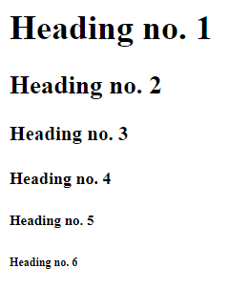
Tags in HTML – Heading tags in HTML
HTML Headings:-
HTML headings are titles or subtitles that you want to display on a webpage.
<h1> is the largest heading tag and
<h6 > is the smallest one
<h1>Heading no. 1</h1>
<h2>Heading no. 2</h2>
<h3>Heading no. 3</h3>
<h4>Heading no. 4</h4>
<h5>Heading no. 5</h5>
<h6>Heading no. 6</h6>

Slide 47
Tags in HTML – Text Level Elements
Displaying Texts and like breaks
Tag | Description
<p> | This tag represents a paragraph.
<h1> to <h6> | Defines header 1 to header 6
<br> | Inserts a single line break
<hr> | Defines a horizontal rule
<!--> | Defines a comment
<p> - Paragraph Tag
The <p> tag defines a paragraph. Browsers automatically add some space (margin) before and after each <p> element..
<p>This is a paragraph</p>
<br> Line Breaks:-
The <br> tag is used when we want to start a new line, but don't want to start a new paragraph.
This Code | output
<p>This <br> is a para<br> graph with line breaks</p> | This is a para graph with line breaks
<hr> The element is used for horizontal rules that act as dividers between sections

Slide 48
Tags in HTML – Text Formatting tags
HTML Text Formatting Elements
HTML Formatting is a process of formatting text for better look and feel.
Element name | Description
<b> | Bold Text
<strong> | This is a logical tag, which tells the browser that the text is important.
<i> | used to make text italic.
<em> | used to display content in italic.
<mark> | This tag is used to highlight text.
<u> | used to underline text written between it.
<strike> | This tag is used to draw a strikethrough on a section of text
<sup> | -Superscript text
<sub> | Subscript text
<del> | This tag is used to display the deleted content.
<ins> | This tag displays the content which is added
<big> | This tag is used to increase the font size by one conventional unit.
<small> | This tag is used to decrease the font size by one unit from base font size.

Slide 49
Tags in HTML – Text Formatting tags
Adding the spaces between text:
Web page shows only one space between the two words. It does not matter that how much we have pressed the spacebar.
If we want to show more than one space before or after the text on the webpage then we have to give the following tag:
&nbsp Non-breaking space
This tag is used for displaying only one space between the text.
<p>There is one space between these&nbsp;words.</p>
<p>There are two spaces between these&nbsp;&nbsp;words.</p>
<p>There are five spaces between these&nbsp;&nbsp;&nbsp;&nbsp;&nbsp;words.</p>
There is one space between these words.
There are two spaces between these words.
There are five spaces between these words.

Slide 50
Tags in HTML – Text Formatting tags
Adding the spaces between text:
If we want to insert/add the longer space then we also use the following tags for showing two or four spaces between the text on the web page:
&ensp; This tag is used for displaying two spaces.
&emsp; This tag is used for displaying four space
We can also add the <pre> tag, which displays the text on the web page as same as entered in the Html document.
<pre> Any text or paragraph </pre>

Slide 51
Tags in HTML – Special Character tags
Some Useful HTML Character Entities
symbol | Description | Entity Name | Entity Number
 | non-breaking space | &nbsp; | &#160;
< | less than | &lt; | &#60;
> | greater than | &gt; | &#62;
& | ampersand | &amp; | &#38;
" | double quotation mark | &quot; | &#34;
' | single quotation mark (apostrophe) | &apos; | &#39;
¢ | cent | &cent; | &#162;
£ | pound | &pound; | &#163;
¥ | yen | &yen; | &#165;
€ | euro | &euro; | &#8364;
© | copyright | &copy; | &#169;
® | registered trademark | &reg; | &#174;

Slide 52
Tags in HTML – Anchor tag
Anchor tag <a>
The HTML anchor tag defines a hyperlink that links one page to another page.
It can create hyperlink to other web page as well as files, location, or any URL.
syntax
<a href = “url"> Link Text </a>
Ex:
<a href = “www.goolge.com"> Click Here </a>
<a href = “home.html"> Home page</a>

Slide 53
Tags in HTML – Anchor tag example
Program to create a Hyperlink
<!DOCTYPE html>
<html>
<head>
<title></title>
</head>
<body>
Click on <a href="https://www.chitkara.edu.in/" target="_blank"> this-link </a>to go on home page of Chitkara University.
</body>
</html>

Slide 54
<!DOCTYPE html>
<html>
<body>
<h1>HTML Links</h1>
<p><a href="https://www.google.co.in/">Visit Google !</a></p>
</body>
</html>

Slide 55
Absolute URLs vs. Relative URLs
Both examples above are using an absolute URL (a full web address) in the href attribute.
A local link (a link to a page within the same website) is specified with a relative URL (without the "https://www" part):

Slide 56
Adding Internal Links/External link in Anchor Tag
External Link
Points to a page on another website.
Example:
<a href="https://www.google.com" target="_blank">Visit Google</a>
Here: target="_blank" opens the external link in a new tab.

Slide 57
Adding Internal Links in anchor tag
Internal Link
Points to another page or section within the same website.
<a href="about.html">About Us</a> <!-- Links to about.html in the same site -->
Or to a section on the same page:
<a href="#contact">Contact Section</a>
<!-- Somewhere in the page -->
<h2 id="contact">Contact Us</h2>
Adding Internal Links to a Web Page
Link to a section within the same page:
<a href="#about">Learn About Us</a>
<!-- Target Section -->
<section id="about">
<h2>About Our Company</h2>
<p>We are dedicated to providing the best services.</p>
</section>

Slide 58
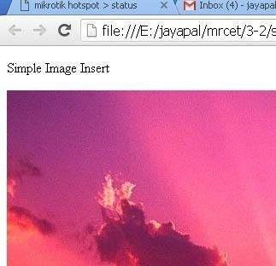
Tags in HTML – Image tag
IMAGES
<img> tag
The HTML <img> tag is used to embed an image in a web page.
Closing tags are not used in HTML image element.
The <img> tag has two required attributes:
  src - Specifies the path to the image
  alt - Specifies an alternate text for the image
Insert Image :
we can insert any image in web page by using <img> tag.
  Syntax:
  <img src = "Image URL" attributes-list>
  Ex.:
  <img src="C:\Users\Pictures\flowe.jpeg" alt=“A pixabay flower">

Slide 59

Tags in HTML – Image tag (Size)
IMAGES:
Set Image Width/Height
<img src = "/html/images/test.png" alt = "Test Image" width = "150" height = "100"/>
<html>
<body>
<h2>Image Size</h2>
<img src=“flower.jpg" alt=“A Pixabay flower” width="500" height="600">
</body>
</html>

Slide 60
Tags in HTML – Image tag (Alignment)
IMAGES
IMAGE ALIGNMENT
The align attribute specifies the horizontal and vertical alignment of the image in relation to the surrounding text/elements.
Example
<img src = "test.png" alt = "Test Image"align = "right"/>
Value | Description
left | Align the image to the left
right | Align the image to the right
top | Align the image on the top
bottom | Align the image on the bottom
Middle | Align the image on the middle

Slide 61
Tags in HTML – Image tag (Borders)
IMAGES:
SET IMAGE BORDER:
The <img> border attribute is used to specify the border width around the image.
The default value of <img> border attribute is 0.
It is not supported by HTML 5. Use CSS instead of this attribute
<img src = "test.png" alt = "Test Image" border = "3"/>

Slide 62
TABLE TAGS

Slide 63

Tables
HTML table tag is used to display data in tabular form (row * column)
A table is created using the following tags.
<table> element, with the help of <tr> , <td>, and <th> elements.
<html>
<head> <title>HTML Tables</title> </head>
<body>
<table border="1">
<tr>
<td>Jill</td>
<td>Smith</td>
<td>50</td>
</tr>
<tr>
<td>Eve</td>
<td>Jackson</td>
<td>94</td>
</tr>
</table>
</body>
</html>
Tag | Description
<table> | It defines a table.
<tr> | It defines a row in a table.
<th> | It defines a header cell in a table.
<td> | It defines a cell – table data in a table.
<caption> | It defines the table caption.

Slide 64
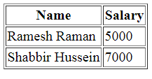
Tables
Table Heading
Table heading can be defined using <th> tag. This tag will be put to replace <td> tag.
<html>
<head>
<title>HTML Table Header</title>
</head>
<body>
<table border = "1">
<tr>
<th>Name</th>
<th>Salary</th>
</tr>
<tr>
<td>Ramesh Raman</td>
<td>5000</td>
</tr>
<tr>
<td>Shabbir Hussein</td>
<td>7000</td>
</tr>
</table>
</body>
</html>

Slide 65
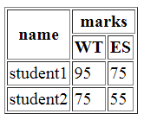
Tables - Colspan and Rowspan Attributes:
We can use colspan attribute if we want to merge two or more columns into a single column.
Similar way we will use rowspan if we want to merge two or more rows.
<html>
<head>
<title>HTML Table Colspan/Rowspan</title>
</head>
<body>
<table border = "1">
<tr>
<th rowspan = "2">name</th>
<th colspan = “2">marks</th>
</tr>
<tr>
<th>WT</th>
<th>ES</th>
</tr>
<tr>
<td>student1</td>
<td>95</td>
<td>75</td>
</tr>
<tr>
<td >student2</td>
<td>75</td>
<td>55</td>
</tr>
</table> </body> </html>

Slide 66
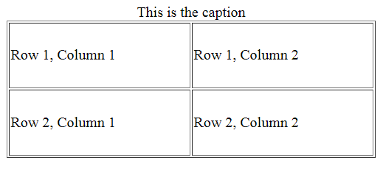
Tables- Height and Width attributes
We can set a table width and height using width and height attributes.
Specify table width or height in terms of pixels or in terms of percentage of available screen area.
Table Caption
The caption tag will serve as a title or explanation for the table and it shows up at the top of the table. This tag is deprecated in newer version of HTML/XHTML
<html>
<head>
<title>HTML Table Width/Height</title>
</head>
<body>
<table border = "1" width = "400" height = "150">
<caption>This is the caption</caption>
<tr>
<td>Row 1, Column 1</td>
<td>Row 1, Column 2</td>
</tr>
<tr>
<td>Row 2, Column 1</td>
<td>Row 2, Column 2</td>
</tr>
</table>
</body>
</html>

Slide 67
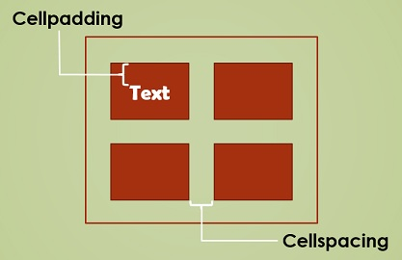
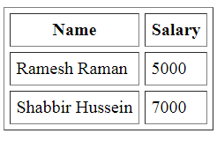
Tables : Cellpadding and Cell-spacing Attributes
cellpadding and cellspacing which are used to adjust the white space in table cells.
The cellspacing attribute defines space between table cells.
cellpadding represents the distance between cell borders and the content within a cell.
<html>
<head>
<title>HTML Table Cellpadding</title>
</head>
<body>
<table border = "1" cellpadding = "5" cellspacing = "5">
<tr>
<th>Name</th>
<th>Salary</th>
</tr>
<tr>
<td>Ramesh Raman</td>
<td>5000</td>
</tr>
<tr>
<td>Shabbir Hussein</td>
<td>7000</td>
</tr>
</table>
</body>
</html>

Slide 68
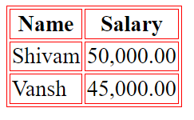
Tables – bordercolor
we can also set border color also using bordercolor attribute.
<html>
<head>
<title>HTML Tables</title> </head>
<body>
<table border="1"bordercolor="red" >
<tr>
  <th>Name</th>
  <th>Salary</th>
</tr>
<tr>
  <td>Shivam</td>
  <td>50,000.00</td>
</tr>
<tr>
  <td>Vansh</td>
  <td>45,000.00</td>
</tr>
</table>
</body>
</html>

Slide 69
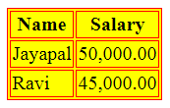
Tables – Backgrounds
Tables Backgrounds
bgcolor attribute − we can set background color for whole table or just for one cell.
background attribute − we can set background image for whole table or just for one cell.
<html>
<head>
<title>HTML Tables</title> </head>
<body>
<table border="1"bgcolor="yellow">
<tr>
  <th>Name</th>
  <th>Salary</th>
</tr>
<tr>
  <td>Jayapal</td>
  <td>50,000.00</td>
</tr>
<tr>
  <td>Ravi</td>
  <td>45,000.00</td>
</tr>
</table>
</body>
</html>

Slide 70
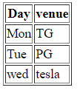
Tables – table body <tbody>
HTML <tbody> tag is used to group the table rows (<tr>) together, which indicates that this is body part of a table (<table>).
The <tbody> tag must be a child of <table> element.
The <tbody> is used along with <thead> and <tfoot> which shows the different part of the table that are table head, table body, and table footer, however, it does not affect the layout of the table.
<!DOCTYPE html>
<html>
<h1>The thead, tbody, and tfoot elements</h1>
<table border="1">
<thead>
<tr>
<th>Day</th>
<th>venue</th>
</tr>
</thead>
<tbody>
<tr>
<td>Mon</td>
<td>TG</td>
</tr>
<tr>
<td>Tue</td>
<td>PG</td>
</tr>
</tbody>
<tfoot>
<tr>
<td>wed</td>
<td>tesla</td>
</tr>
</tfoot>
</table>
</body>
</html>

Slide 71
Tags in HTML – Lists
LISTS
  A list is a collection of items.
  HTML offers web authors three ways for specifying lists of information.
  All lists must contain one or more list elements
  Lists are of three types
  1. Un ordered list <ul> Items marked with bullets.
  2. Ordered List <ol> Items marked with numbers or letters
  3. Definition list <dl> Arranges items in the same way as they are arranged in a dictionary.
html
css
javascript
Coffee
Tea
Milk
Coffee
  - black hot drink
Milk
  - white cold drink

Slide 72
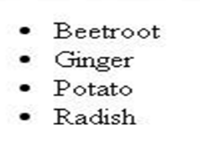
Tags in HTML – Lists (Unordered lists)
LISTS
Unordered Lists :
  An unordered list is a collection of related items that have no special order or sequence.
  This list is created by using HTML <ul> tag.
  Each item in the list is marked with a bullet.
Example
<html>
<head>
<title>HTML Unordered List</title>
</head>
<body>
<ul> <li>Beetroot</li>
<li>Ginger</li>
<li>Potato</li>
<li>Radish</li>
</ul>
</body>
</html>

Slide 73
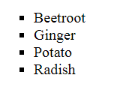
Tags in HTML – Lists
Tags in HTML – Lists (Unordered lists)
UNORDERD LISTS WITH “TYPE” ATTRIBUTE
The type Attribute
we can use type attribute for <ul> tag to specify the type of bullet we like. By default, it is a disc.
Following are the possible options −
  <ul type = "square"> <ul type = "disc"> <ul type = "circle">
Example
<html>
<head> <title>HTML Unordered List</title> </head>
<body>
<ul type = "square">
  <li>Beetroot</li>
  <li>Ginger</li>
  <li>Potato</li>
  <li>Radish</li>
</ul>
</body>
</html>

Slide 74
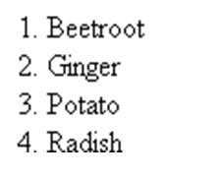
Tags in HTML – Lists (Ordered lists)
ORDERED LISTS
Ordered Lists:-
Items are numbered list instead of bulleted, This list is created by using <ol> tag.
The numbering starts at one and is incremented by one for each successive ordered list element tagged with <li>.
Example
<!DOCTYPE html>
<html>
<head>
<title>HTML Ordered List</title>
</head>
<body>
<ol>
<li>Beetroot</li>
<li>Ginger</li>
<li>Potato</li>
<li>Radish</li>
</ol>
</body>
</html>

Slide 75
Tags in HTML – Lists (Ordered lists)
ORDERED LISTS WITH TYPE ATTRIBURE
The type Attribute:
we can use type attribute for <ol> tag to specify the type of numbering we like. By default, it is a number. Following are the possible options.
  <ol type = "1"> - Default-Case Numerals.
  <ol type = "I"> - Upper-Case Numerals.
  <ol type = "i"> - Lower-Case Numerals.
  <ol type = "A"> - Upper-Case Letters.
  <ol type = "a"> - Lower-Case Letters.
<html>
<head> <title>HTML Ordered List</title> </head> <body>
<ol type = "1">
  <li>Beetroot</li>
  <li>Ginger</li>
  <li>Potato</li>
  <li>Radish</li>
</ol>
</body>
</html>

Slide 76
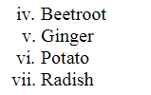
Tags in HTML – Lists (Ordered lists)
ORDERED LISTS WITH “START” ATTRIBURE
The start Attribute
we can use start attribute for <ol> tag to specify the starting point of numbering we need. Following are the possible options −
  <ol type = "1" start = "4"> - Numerals starts with 4.
  <ol type = "I" start = "4"> - Numerals starts with IV.
  <ol type = "i" start = "4"> - Numerals starts with iv.
  <ol type = "a" start = "4"> - Letters starts with d.
  <ol type = "A" start = "4"> - Letters starts with D.
<html>
<head> <title>HTML Ordered List</title> </head>
<body>
<ol type = "i" start = "4">
  <li>Beetroot</li>
  <li>Ginger</li>
  <li>Potato</li>
  <li>Radish</li>
</ol>
</body>
</html>

Slide 77
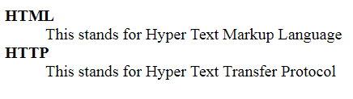
Tags in HTML – Lists (Definition lists)
DEFINITION LISTS
Definition Lists:
HTML supports a list style which is called definition lists where entries are listed like in a dictionary or encyclopedia.
The definition list is the ideal way to present a glossary, list of terms, or other name/value list.
Definition List makes use of following three tags.
1). <dl> - Defines the start of the list
</dl> - Defines the end of the list
2). <dt> - A term
. <dd> - Term definition
<html>
<head>
<title>HTML Definition List</title>
</head>
<body>
<dl>
<dt>HTML</dt>
<dd>This stands for Hyper Text Markup Language</dd>
<dt>HTTP</dt>
<dd>This stands for Hyper Text Transfer Protocol</dd>
</dl>
</body>
</html>

Slide 78
Media Tags
Multimedia tags include:
Image
Video
Audio
Flash Files
Marquee
1.Image Tag: The <img> HTML element embeds an image into the document. It has various attributes such as
src attribute is required and contains path to the image you want to embed.
alt (alternative text) attribute holds a textual replacement for the image, which is mandatory and incredibly useful for
accessibility — screen readers read the attribute value out to their users so they know what the image means.
Alt text is also displayed on the page if the image can't be loaded for some reason: for example, network errors, content blocking etc.

Slide 79
hspace: (Horizontal space) The number of pixels of white space on the left and right of the image.
Use the margin CSS property instead.
vspace: (vertical space) The number of pixels of white space above and below the image.
Use the margin CSS property instead.
width/height: The intrinsic width/height of the image in pixels. Must be an integer without a unit.
<img src="3_small.jpg"
width="550" height="450" border="10"
hspace="400" vspace="100" alt="Sunset View">
USE IMAGE DIRECTLY FROM INTERNET WITHOUT DOWNLOADING
Right click on image and click copy image address and paste in src attribute

Slide 80
2. Video
Code to embed video:
<video width="320" height="240" controls autoplay muted loop>
<source src="Colourmixing.mp4“ type="video/mp4">
<source src="movie.ogg" type="video/ogg">
Your browser does not support the video tag.
</video>
The <video> tag is used to embed video content in a document. The <video> tag contains one or more <source> tags with different video sources. The browser will choose the first source it supports. The text between the <video> and </video> tags will only be displayed in browsers that do not support the <video> element. There are three supported video formats in HTML: MP4, WebM, and OGG.
Attributes:
Controls: Specifies that video controls should be displayed (such as a play/pause button etc).
Loop: Specifies that the video will start over again & again, every time it is finished.
We cannot set the number of times a video is played i.e. No control over loop attribute but we can use JavaScript to set loops.

Slide 81
Autoplay: Specifies that the video will start playing upon page load. Many browsers can only autoplay the videos with sound off, so you'll need to add muted attribute
Muted: specifies that the audio output of the video should be muted. Controls, loop, autoplay and loop are boolean attributes.

Slide 82
3. Audio 4. Flash
Code to include audio file:
<audio controls loop>
<source src="abc.m4a">
<source src="horse.mp3" type="audio/mpeg">
Your browser does not support the audio tag.
</audio>
Code to include flash/animated file:
<embed src="ball.svg" width="500" height="450">
Svg: Scalable vector Graphics

Slide 83
5. Marquee
It is used to scroll an image or text horizontally or vertically. But this tag has been deprecated in HTML 5.
<marquee> WELCOME </marquee>
<marquee bgcolor="lightgreen"><font size=”5” >
WELCOME </font> </marquee>

Slide 84
Attributes of Marquee Tag
Attribute | Values | Description
Direction | left, right, up, down | Specifies the direction in which the marquee content scrolls.
Behavior | scroll, slide, alternate | Defines the type of movement of the marquee. 'scroll' is the default behavior, causing the content to scroll endlessly. 'slide' makes the content slide in and stop. 'alternate' causes the content to bounce back and forth.
scrollamount | number | Defines the speed of the marquee text. Higher values result in faster scrolling. Default=6
Scrolldelay | number | Sets the delay in milliseconds between each movement. Higher values result in slower scrolling.
Loop | number | Specifies the number of times the marquee should loop. The default is infinite.
Bgcolor | color | Sets the background color of the marquee. You can use color names or hex codes.
Width | value (in px, %, etc.) | Sets the width of the marquee. It can be in pixels, percentages, etc.
Height | value (in px, %, etc.) | Sets the height of the marquee. It can be in pixels, percentages, etc.

Slide 85
Behavior: It has 3 values:
Scroll: It is default property. It is used to scroll the text from right to left, and restarts at the right side of the marquee when it is reached to the end of left side.
Slide: In this marquee, all the contents to be scrolled will slide the entire length of marquee but stops at the end to display the content permanently.
Alternate: It scrolls the text from right to left and goes back left to right.
<marquee bgcolor="lightgreen"
behavior="slide" direction="right“
scrollamount="25" width="60%"
height="200"
hspace="250" vspace="200" loop="4">

Slide 86
FORMS

Slide 87
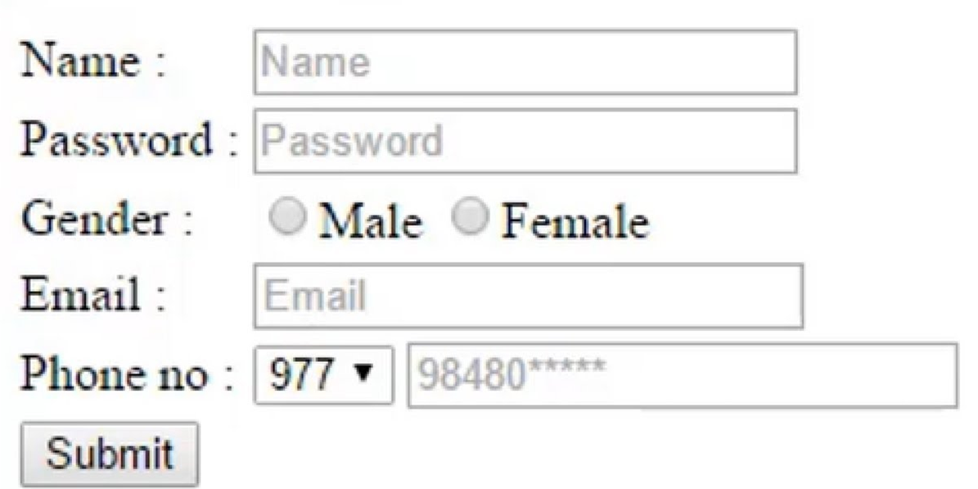
FORMS:
An HTML form is a section of a document which contains controls such as
  text fields,
  password fields,
  checkboxes,
  radio buttons,
  submit button,
  menus etc.
An HTML form facilitates the user to enter data that is to be sent to the server for processing such as name, email address, password, phone number, etc. .
There are various form elements available like text fields, text area fields, drop-down menus, radio buttons, checkboxes, etc.

Slide 88
HTML Form Tags:
<form>
The HTML <form> element defines a form that is used to collect user input:
  <form action="server url" method="get|post">
  //input controls e.g. textfield, textarea, radiobutton, button
  </form>
Sr.No | Attribute & Description
1 | action : Backend script ready to process your passed data.
2 | method: It to be used to upload data. The most frequently used are GET and POST methods.
3 | target : Specify the target window or frame where the result of the script will be displayed. It takes values like _blank, _self, _parent etc.

Slide 89
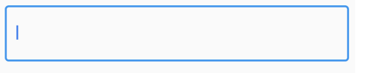






FORMS:
<input> - It defines an input control.
The <input> element can be displayed in several ways, depending on the type attribute.
Type | Description
<input type="text"> | Defines a one-line text input field
<input type="password"> | Defines a password field
<input type="checkbox"> | Defines a checkbox
<input type="button"> | Defines a clickable button (mostly used with a JavaScript to activate a script)
<input type=“file"> | Defines a file-select field and a "Browse" button (for file uploads)
<input type="radio"> | Defines a radio button (for selecting one of many choices)
<input type="submit"> | Defines a submit button (for submitting the form)

Slide 90
FORMS:
HTML Form Controls
There are different types of form controls that you can use to collect data using HTML form −
Text field
Password Field
Text Area
Checkbox
Radio Box
Select Box
File Select boxes
Buttons

Slide 91
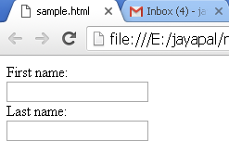
FORMS:
Text field (or) Single-line text input control
  This control is used for items that require only one line of user input, such as search boxes or names. They are created using HTML <input> tag.
<html>
<head>
<title>Text Input Control</title>
</head>
<body>
<form >
First name: <input type = "text" name = "first_name" />
<br>
Last name: <input type = "text" name = "last_name" />
</form>
</body>
</html>
Sr.No | Attribute & Description
type | Indicates the type of input control and for text input.
name | Used to give a name to the control
value | This can be used to provide an initial value
size | Allows to specify the width of the text-input control in terms of characters.
maxlength | Allows to specify the maximum number of characters a user can enter into the text box.

Slide 92

FORMS:
2. Password Field
This is also a single-line text input but it masks the character as soon as a user enters it.
They are also created using HTML <input>tag but type attribute is set to password.
<html>
<head> <title>Password Input Control</title> </head>
<body>
<form >
User ID : <input type = "text" name = "user_id" />
<br> Password:
<input type = "password" name = "password" />
</form>
</body>
</html>

Slide 93
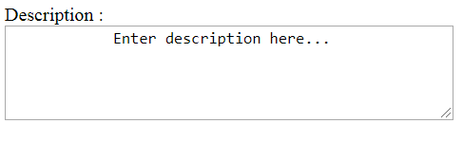
FORMS:
3. Text Area (or) Multiple-Line Text Input Control
This is used when the user is required to give details that may be longer than a single sentence.
Multi-line input controls are created using HTML <textarea> tag.
<html>
<head>
<title>Multiple-Line Input Control</title>
</head>
<body>
<form>
Description :<br>
<textarea rows = "5" cols = "50" name = "description">
Enter description here...
</textarea>
</form>
</body>
</html>

Slide 94
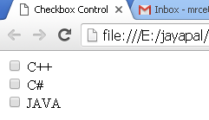
FORMS:
4. Checkbox Control
Checkboxes are used when more than one option is required to be selected. They are also created using HTML <input> tag but type attribute is set to checkbox.
<html> <head> <title>Checkbox Control</title> </head>
<body>
<form>
  <input type="checkbox" name="C++" value="on"> C++
  <br>
  <input type="checkbox" name="C#" value="on"> C#
  <br>
  <input type="checkbox" name="JAVA" value="on"> JAVA
</form>
</body> </html>

Slide 95
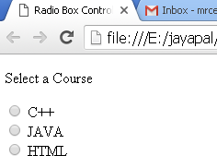
FORMS:
5. Radio Button Control
  Radio buttons are used when out of many options, just one option is required to be selected. They are also created using HTML <input> tag but type attribute is set to radio
<html>
<head>
<title>Radio Box Control
</title> </head>
<body> <p>Select a Course</p>
<form>
  <input type="radio" name="subject" value="C++"> C++
  <br>
  <input type="radio" name="subject" value="JAVA"> JA VA
  <br>
  <input type="radio" name="subject" value="HTML"> HTML
</form> </body> </html>

Slide 96
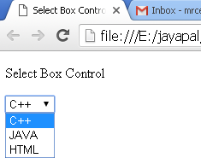
FORMS:
6. Select Box Controls
  A select box, also called drop down box which provides option to list down various options in the form of drop down list, from where a user can select one or more options
<html>
<head>
<title>Select Box Control</title>
</head>
<body>
<form>
<select name="dropdown">
  <option value="C++" selected>C++</option>
  <option value="JAVA">JA VA</option>
  <option value="HTML">HTML</option>
</select>
</form>
</body>
</html>

Slide 97
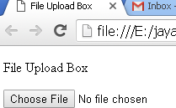
FORMS:
7. File Select boxes
  If we want to allow a user to upload a file to web site, we will need to use a file upload box, also known as a file select box. This is also created using the <input > element but type attribute is set to file.
<html>
<head>
<title>File Upload Box</title>
</head>
<body>
<p>File Upload Box</p>
<form>
  <input type="file" name="fileupload" >
</form>
</body>
</html>

Slide 98
FORMS:
8. Buttons
  There are various ways in HTML to create clickable buttons.
  we can also create a clickable button using <input> tag by setting its type attribute to button. The type attribute can take the following values:
Sr.No | Type & Description
submit | This creates a button that automatically submits a form.
reset | This creates a button that automatically resets form controls to their initial values.
button | This creates a button that is used to trigger a client-side script when the user clicks that button.
image | This creates a clickable button but we can use an image as background of the button.
<html>
<head>
<title>File Upload Box</title>
</head>
<body>
<form>
<input type="submit" name="submit" value="Submit" />
  <input type="reset" name="reset" value="Reset" />
  <input type="button" name="ok" value="OK" />
  <input type="image" name="imagebutton" src="test1.png" />
</form>
</body>
</html>

Slide 99
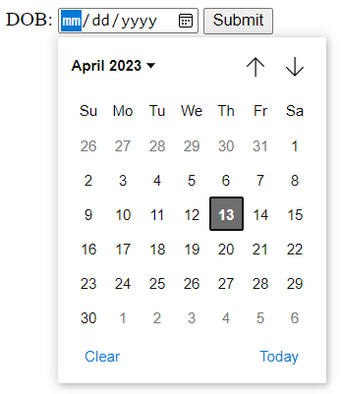
Displaying date picker
9. HTML <input type="date">
  The <input type="date"> defines a date picker.
  The resulting value includes the year, month, and day.attribute
<html>
<body>
<h1>Show a Date Control</h1>
<form>
DOB: <input type="date" id="birthday" name="birthday">
<input type="submit">
</form>
</body>
</html>

Slide 100
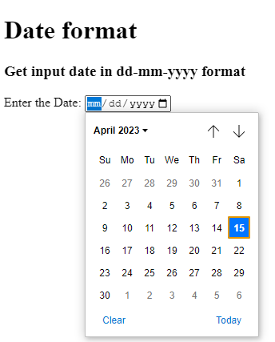
Displaying date picker with dd/mm/yyyy format and ranges
10. HTML <input type="date">
  To set and get the input type date in dd-mm-yyyy format we will use attribute
  placeholder="dd-mm-yyyy“.
  We can also mention the start and end dates for the date picker with min and max attributes.
<html>
<body>
<h1>Date format</h1>
<h3> Get input date in
dd-mm-yyyy format </h3>
<label for="start"> Enter the Date: </label>
<input type="date" name="start"
placeholder="dd-mm-yyyy"
min="1997-01-01" max="2030-12-31">
</body>
</html>

Slide 101
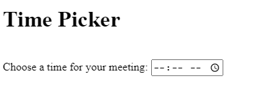
Displaying time picker
11. HTML <input type=“time">
  The <input type="date"> defines a date picker.
  placeholder="dd-mm-yyyy“.
  We can also mention the start and end dates for the date picker with min and max attributes.
<html>
<body>
<label for="appt">Choose a time for your meeting:</label>
<input type="time" id="appt" name="appt"
min="09:00" max="18:00" required>
<small>Office hours are 9am to 6pm</small>
</body>
</html>

Slide 102
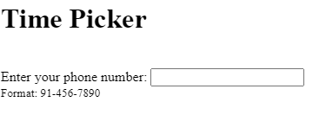
Telephone number
12. <input type="tel">
The <input type=“tel"> defines a telephone number.
<html>
<body>
<label for="appt">Choose a time for your meeting:</label>
<input type="time" id="appt" name="appt"
min="09:00" max="18:00" required>
<small>Office hours are 9am to 6pm</small>
</body>
</html>

Slide 103

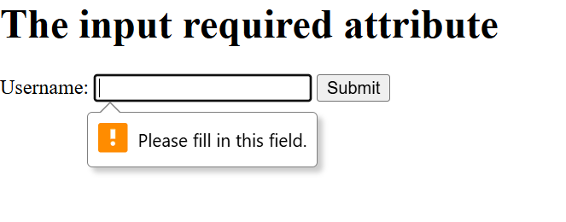

RANGE
<input type="range" id="a" value="50">
The input required attribute
<!DOCTYPE html>
<html>
<body>
<h1>The input required attribute</h1>
<form action="/action_page.php">
<label for="username">Username:</label>
<input type="text" id="username" name="username" required>
<input type="submit">
</form>
</body>
</html>
Lastname:<input type="text" name="lastname" value="sharma" readonly>

Slide 104
Hidden fields
<input type="hidden" name="hiddenField" value="nyah"> &lt;-- right there, don't you see it?
What good is this?
  All input fields are sent back to the server, including hidden fields
  This is a way to include information that the user doesn’t need to see (or that you don’t want him/her to see)
  The value of a hidden field can be set programmatically (by JavaScript) before the form is submitted

Slide 105
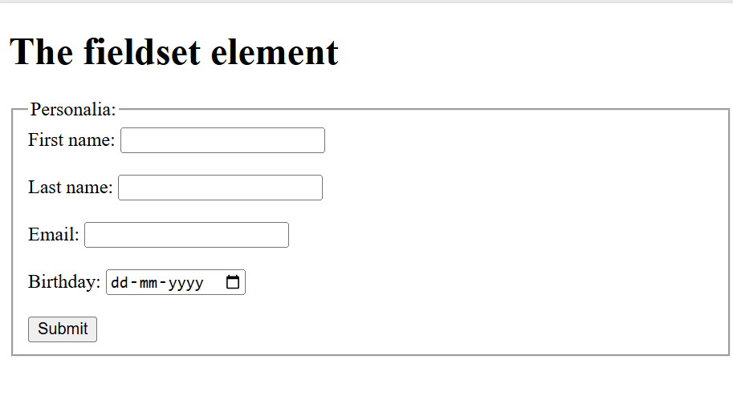
HTML <fieldset> Tag
The <fieldset> tag is used to group related elements in a form.
The <fieldset> tag draws a box around the related elements.
<!DOCTYPE html>
<html>
<body>
<h1>The fieldset element</h1>
<form action="/action_page.php">
<fieldset>
<legend>Personalia:</legend>
<label for="fname">First name:</label>
<input type="text" id="fname" name="fname"><br><br>
<label for="lname">Last name:</label>
<input type="text" id="lname" name="lname"><br><br>
<label for="email">Email:</label>
<input type="email" id="email" name="email"><br><br>
<label for="birthday">Birthday:</label>
<input type="date" id="birthday" name="birthday"><br><br>
<input type="submit" value="Submit">
</fieldset>
</form>
</body>
</html>

Slide 107
Code to create a html Form
<!DOCTYPE html>
<html>
<head>
<title>Form</title>
</head>
<body bgcolor="pink">
<center><font color="red" size="7">Application Form</font></center>
<hr size="5" color="blue" width="400">
<form action="a.html" method="GET">
<table align="center" cellspacing="5" cellpadding="5">
<tr>
<td>First Name:</td>
<td><input type="text" name="fname" placeholder=“name" size="30" maxlength="6" /></td>
</tr>
<tr>
<td>Last Name:</td>
<td><input type="text" name="lname" value="" size="30"/></td>
</tr>

Slide 108
<tr> <td>Password:</td>
<td><input type="password" name="pwd"/></td>
</tr>
<tr> <td>Comments:</td>
<td><textarea rows="8" cols="20" name="comm" placeholder="enter comments"></textarea></td>
</tr>
<tr> <td>Language</td>
<td><input type="checkbox" name="cb1"checked>Hindi
<input type="checkbox" name="cb1"> English
<input type="checkbox" name="cb1">Punjabi</td>
</tr>
<tr><td>Gender:</td>
<td><input type="radio" name="r1">Male
<input type="radio" name="r1">Female</td>
</tr>

Slide 109
<tr>
<td>Select fruit:</td>
<td><select name="s1">
<option>----select----</option>
<option>Orange</option>
<option>Mango</option>
<option>Pineapple</option>
<option>Strawberry</option>
</select></td>
</tr>
<tr>
<td>Select Resume</td>
<td><input type="file"/></td>
</tr>

Slide 110
<tr>
<td align="center" colspan="2">
<input type="submit" value="REGISTER"/>
<input type="reset" value="CLEAR"/>
<input type="button" value="OK"/></td>
</tr>
</table>
</form>
</body>
</html>

Slide 111

Favicon
A favicon is a small image displayed next to the page title in the browser tab.
HTML Favicon is a small icon representing a website, appearing in the browser’s tab or bookmark bar. Defined using the <link> tag with `rel=”icon”`, it is also known as the Favorite icon.

Slide 112
Adding a Favicon
How to add favicon in HTML?
Add a <link> element to your "html" file, after the <title> element, like this:
<head>
<title> Adding Favicon </title>
<link rel="icon" type="image" href="shopping.png">
</head>
<link> Defines the relationship between a document and an external resource

Slide 113
Favicon
A favicon is a small image displayed next to the page title in the browser tab.
<!DOCTYPE html>
<html>
<head>
<title>My Page Title</title>
<link rel="icon" type="image" href="/images/favicon.ico">
</head>
<body>
<h1>This is a Heading</h1>
<p>This is a paragraph.</p>
</body>
</html>

Slide 114
Meta Tag
The <meta> tag defines metadata about an HTML document. Metadata is data (information) about data.
<meta> tags always go inside the <head> element, and are typically used to specify character set, page description, keywords, author of the document, and viewport settings.
Metadata will not be displayed on the page, but is machine parsable.
Metadata is used by browsers (how to display content or reload page), search engines (keywords), and other web services.
There is a method to let web designers take control over the viewport (the user's visible area of a web page), through the <meta> tag.

Slide 115
<head>
<meta charset="UTF-8">
<meta name="keywords" content="HTML, CSS, JavaScript">
<meta name="description" content="Free Web tutorials for HTML and CSS">
<meta name="author" content="John Doe">
</head>
UTF-8: UTF-8 stands for “Unicode Transformation Format - 8 bits.” UTF-8 is an encoding system for Unicode. It can translate any Unicode character to a matching unique binary string, and can also translate the binary string back to a Unicode character.

Slide 116
What is SEO?
Search Engine Optimization (SEO) is the process of improving a website so that it is easier for search engines to understand and more likely to appear prominently in relevant search results.
Examples of Search Engines
Google
Bing
Yahoo
DuckDuckGo

Slide 117
Why is SEO Important?
Imagine you have built two college websites.
Website A
Proper headings
Meta description
Semantic HTML
Alt text
Responsive layout
Website B
Random headings
No meta tags
No alt text
Poor structure
Which website is easier for search engines to understand?

Slide 118
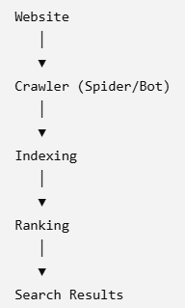
How Search Engines Work
Imagine a huge library containing billions of books.
First, the librarian collects new books.
Then, the librarian organizes them.
Finally, when someone asks for a book, the librarian recommends the most relevant one.
Search engines work in exactly the same way.
Crawling is the process by which search engines discover webpages on the Internet.

Slide 119
Suppose three websites teach HTML.
Website A
Good title
Semantic HTML
Fast loading
Mobile friendly
Images with alt text
Website B
No title
No headings
Poor navigation
Missing alt attributes
Website C
Duplicate content
Slow loading
Broken links
Which website is likely to rank highest?
Answer: Website A
Because it follows good SEO practices.

Slide 120
What Can HTML Do for SEO?
HTML elements important for SEO:
<title>
Meta tags
Heading tags
Semantic HTML
Images (alt)
Hyperlinks
URL structure
Lists
Tables (when used appropriately)

Slide 121
SEO Best Practices
✔ Use descriptive titles.
✔ Add a meta description.
✔ Use semantic HTML.
✔ Use one <h1>.
✔ Use proper heading hierarchy.
✔ Add alt text.
✔ Create meaningful hyperlinks.
✔ Make the website mobile-friendly.
✔ Write original, useful content.

Slide 122
Common SEO Mistakes
❌ Missing page title
❌ Missing meta description
❌ Multiple <h1> elements without purpose
❌ Images without alt
❌ Broken links
❌ Generic anchor text ("Click Here")
❌ Poor page structure

Slide 123
Mini Activity
Improve the following code:
<title>Home</title>
<img src="lab.jpg">
<a href="course.html">Click Here</a>
Students should:
Write a better title.
Add alt text.
Replace the generic link text with a descriptive one.

Slide 124
ANSWER:
The page title "Home" is too generic and does not describe the webpage.
The image is missing the alt attribute, making it less accessible and harder for search engines to understand.
The hyperlink text "Click Here" is not descriptive and does not tell users or search engines where the link leads.
IMPROVED SEO-Friendly CODE:
<title>Computer Science Courses | ABC College</title>
<img src="lab.jpg" alt="Students attending a Computer Science laboratory session">
<a href="course.html">View Computer Science Courses</a>

